Slide 1
Studi Kasus
Dr. Suyanto, S.T., M.Sc.
HP/WA: 0812 845 12345
Intelligence Computing Multimedia (ICM)
Informatics faculty – Telkom University

Slide 2
Perbedaan keempat teknik?
Searching
Reasoning
Planning
Learning
- States
- Operator
8-Puzzle
Knapsack
- Rule Generator
- Data driven
- Knowledge base
- Inference
Pattern Recognition Klasifikasi Klastering
Wumpus Catur
Satu aplikasi mungkin memerlukan beberapa teknik !!!
- Decomposable
- PAD
Manufacture Elevator CS

Slide 3
Outline
Searching
Mobile Navigation System
Optimization
Reasoning
Electronic Medical Records
Planning
Elevator Control System
Learning
Email Spam Filtering
Graphem to Phoneme Converter (G2P)
Kesimpulan

Slide 4
Mobile Navigation System
Tom Tom
Garmin
Bagaimana implementasinya?
Pengembangan

Slide 5
States/simpul?
???
Operator?
Pilih next state

Slide 6
Representasi Database
Satu layer
Bagaimana jika multi layer Database?
Jalan
Hotel
ATM, dll

Slide 7
Teknik AI
Searching?
Reasoning?
Planning?
Learning?
Searching

Slide 8
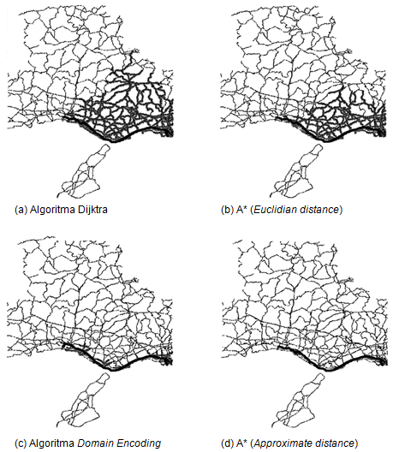
Best
(Kazuaki Yamaguchi and Sumio Masuda, 2006, KAZ06)

Slide 9
Faktor2 yang harus diperhatikan
Kesalahan GPS dalam menentukan posisi obyek.
Kebanyakan produsen MNS mengklaim bahwa tingkat akurasi produknya berada dalam orde senti meter.
Strategi penyimpanan peta di database.
Sistem operasi yang digunakan.
Semua software pembangun MNS.

Slide 10
Pengembangan
Text-to-speech → i-mode (DOCOMO)
Real-time traffic → detouring
Real-time weather reports
Alternative routes
Vehicle Routing Problems (VRP)
Optimasi pendistribusian barang
Zero warehousing
Tour Guide
Optimasi rute kunjungan
Pembuatan jadwal kunjungan

Slide 11
Searching & Optimasi
Matrix Chain-Products
Sequence Alignment
Minimum Spanning Tree
Traveling Salesman Problem
…

Slide 12
Matrix Chain-Products
A → 5 x 1000
B → 1000 x 9
C → 9 x 9
A * (B * C) atau (A * B) * C ?
A * (B * C) → 81.000 + 45.000 = 126.000 operasi
(A * B) * C → 45.000 + 405 = 45.405 operasi
Untuk ratusan atau bahkan ribuan matriks ???

Slide 13
Sequence Alignment
DNA Alignment
Speech recognition
Pengenalan pola: tulisan tangan dengan urutan goresan

Slide 14
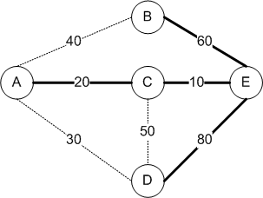
Minimum Spanning Tree
Optimasi Jaringan Telekomunikasi
Optimasi Jaringan Air

Slide 15
Optimization Algorithms
Dunia Hitam?
1

Slide 16
Electronic Medical Records
Sistem Informasi
Kemudahan interaksi antar entitas
Riwayat medis pasien
Reminder
Jadwal
Sistem Cerdas
Persamaan hak dan kewajiban (setiap entitas)
Cek alergi obat
Cek interaksi obat
Cari harga obat yang paling optimal

Slide 18
Cek Alergi Obat
Fakta:
Pasien A sakit Maag, Hepatitis, Diabetes
Pasien B sakit Jantung
Aturan:
IF sakit Maag THEN hindari obat mengandung x2
IF sakit Jantung THEN hindari obat mengandung y2
Knowledge Base
Pengelompokkan jenis penyakit
First Order Logic

Slide 19
Cek interaksi obat
Fakta:
Obat ABC mengandung 100 mg x1, 150 mg x2
Obat XYZ mengandung 100 mg y1, 150 mg y2
Aturan:
IF x1 bercampur dengan y1 THEN interaksi ringan
IF x2 bercampur dengan y2 THEN interaksi berat
Knowledge Base
Pengelompokkan obat
First Order Logic
IF x1 < 100mg bercampur dengan y1 < 100mg THEN interaksi ringan
IF x1 > 100mg bercampur dengan y1 > 100mg THEN interaksi berat

Slide 20
Cari Harga Obat Optimal
Fakta:
Kemampuan finansial pasien
Kandungan dan harga obat
Tujuan:
Cari obat dengan harga yang paling optimal dengan tetap melihat interaksi dan alerginya.

Slide 21
Teknik AI
Searching?
Reasoning?
Planning?
Learning?
Reasoning, Learning, Searching

Slide 22
Knowledge Representation
First Order Logic
Production Rules
Non-monotonic Systems
Statistical Reasoning Systems
Weak Slot-and-Filler Structures
Semantic Nets
Frames System
Strong Slot-and-Filler Structures
Conceptual Dependency Scripts
CYC

Slide 23
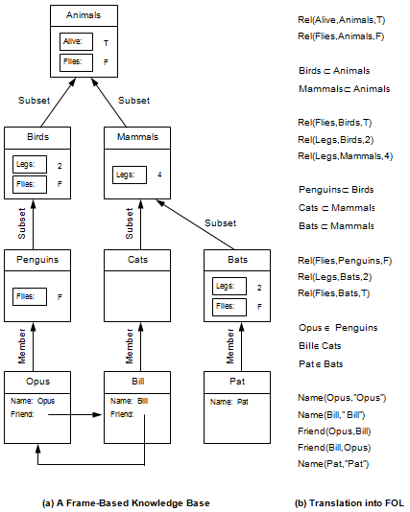

Slide 24
Spam Filtering
Email spam
Email sampah atau email yang tidak diperlukan user
Contoh:
Instant messaging spam
Web search engine spam
Blogs spam
Mobile phone messaging spam, dsb.
Jumlahnya mencapai 90 milyar per hari

Slide 25
From: DOUGLAS M ROBIN douglas_markrobin@yahoo.co.uk
Subject: COMPLETE THE FORM WITH YOUR PASSPORT PHOTO ATTACHED
The National Lottery
PAYMENT/PROCESSING OFFICE, LONDON, UK.
3240 RIDGE-WAY,LONDON NW71RN. 00447040112422
Batch/074/05/ZY3
Ticket/ 5647600545188
Serial No /5073-11
Dear (),
l acknowledge the receipt of your mail, as regard your request the reason is that over the years we have had cases of double claim of winnings and with the help of the verification form its earlier to detect the winners in various category.
Your information is need to process other vital document before your cash prize can be release to you for claim.
l need those vital information alongside passport photo to proceed with the processing of your winnings. l need urgent response in 24 hrs because you have less 2 weeks .
Regards,
Douglas Robin.
(FIDUCIARY OFFICER)

Slide 26
Strategi Spammer
l0ttery
l o t t e r y
l-o-t-t-e-r-y
liottery
l-ottery
lotte’ry

Slide 27
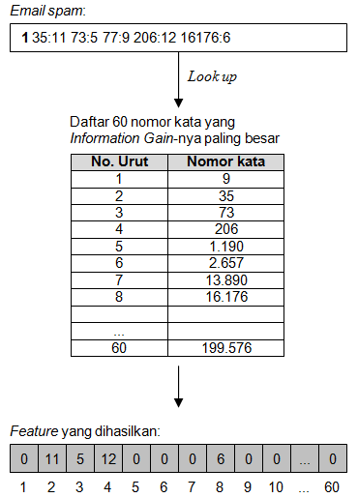
Misal: dari observasi diperoleh jumlah kata yang optimum adalah 60

Slide 28
GRAPHEME-TO-PHONEME (G2P)
Grapheme: simbol string
Phoneme: simbol pengucapan
Bagaimana mengubah grapheme ke phoneme ?
Bagaimana menemukan rule untuk konversi ?

Slide 29
Apel
Apel pagi
Apel Malang
Context Dependent
Natural pronunciation???

Slide 30
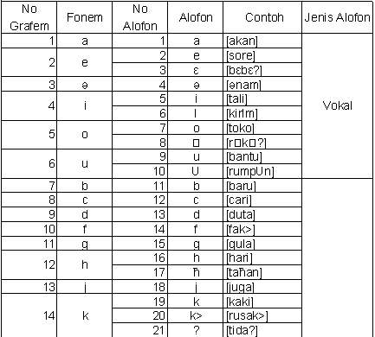
Dan konsonan lainnya …

Slide 31
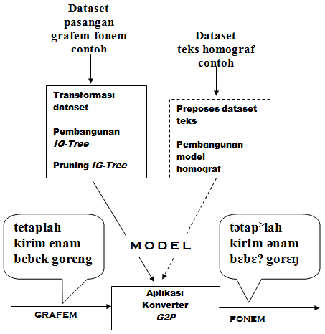
Sumber: INDONESIAN GRAPHEME-TO-PHONEME (G2P) MENGGUNAKAN MODEL IG-TREE + STRATEGI TEBAKAN TERBAIK
Tugas Akhir AGUS HARTOYO 113040329

Slide 32
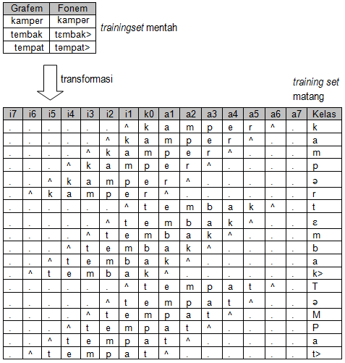

Slide 33
Teknik Learning?
ID3
Multi Layer Perceptron (MLP)
JST Probabilisik
Algoritma Genetika
Gabungan???

Slide 34
Perbedaan keempat teknik?
Searching
Reasoning
Planning
Learning
- States
- Operator
8-Puzzle
Knapsack
- Rule Generator
- Data driven
- Knowledge base
- Inference
Pattern Recognition Klasifikasi Klastering
Wumpus Catur
Satu aplikasi mungkin memerlukan beberapa teknik !!!
- Decomposable
- PAD
Manufacture Elevator CS

Slide 35
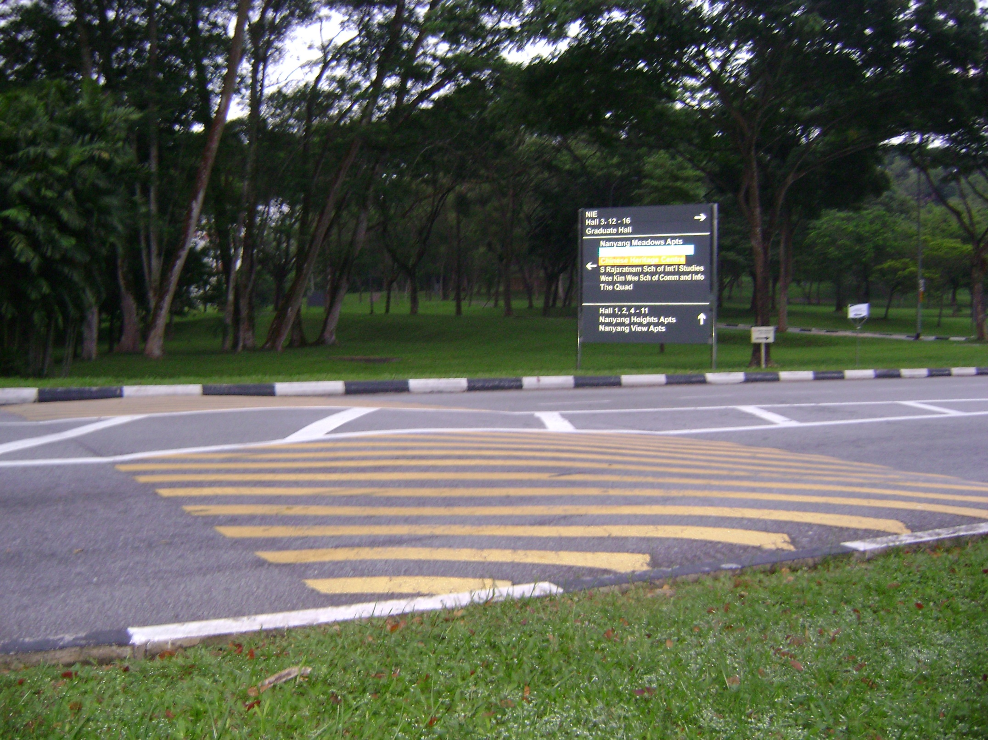
Question?

