Slide 1
CSH4313 Kecerdasan Kolektif (Swarm Intelligence) Masalah Optimasi
Semester Ganjil 2017/2018
Dr. Suyanto, S.T., M.Sc.
Web: http://suyanto.staff.telkomuniversity.ac.id
Email: suyanto@telkomuniversity.ac.id
HP/WA: +62 812 84512345

Slide 2
Optimasi Masalah Kontinu

Slide 3
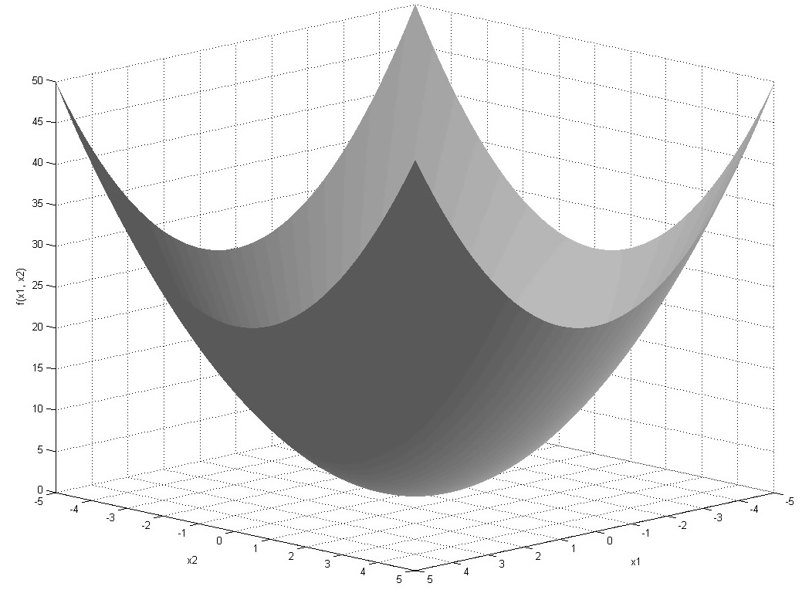

Slide 4
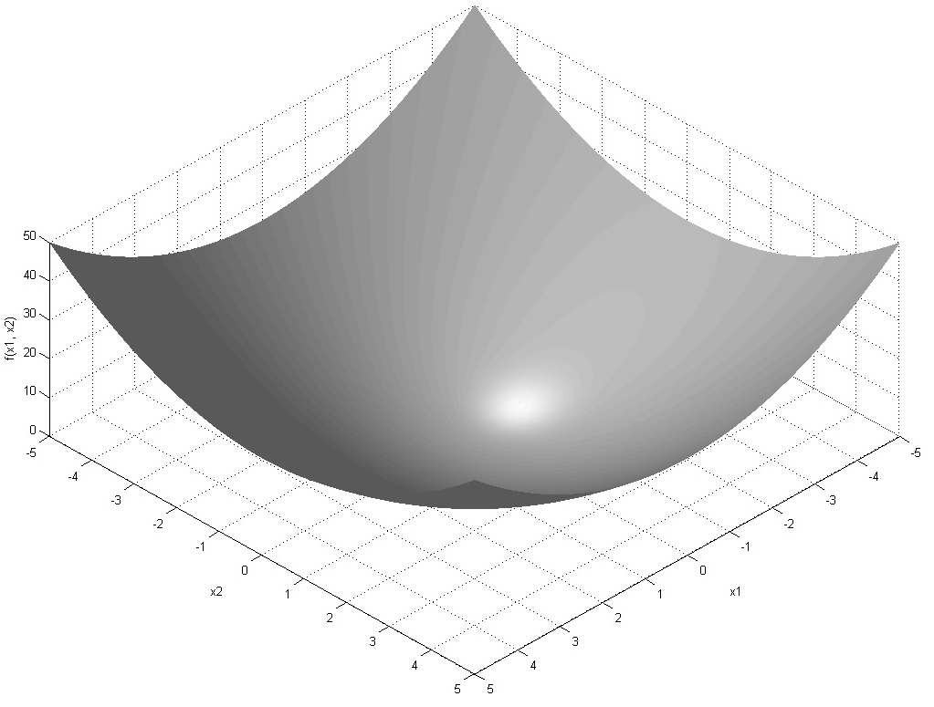

Slide 5
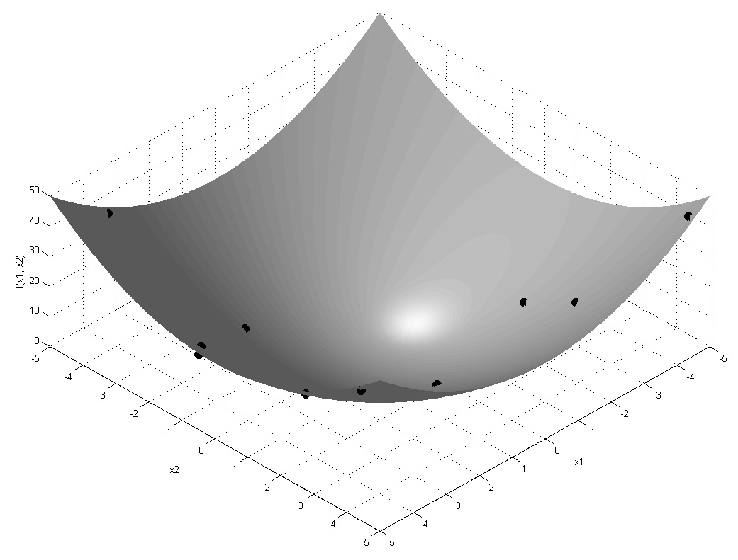

Slide 6
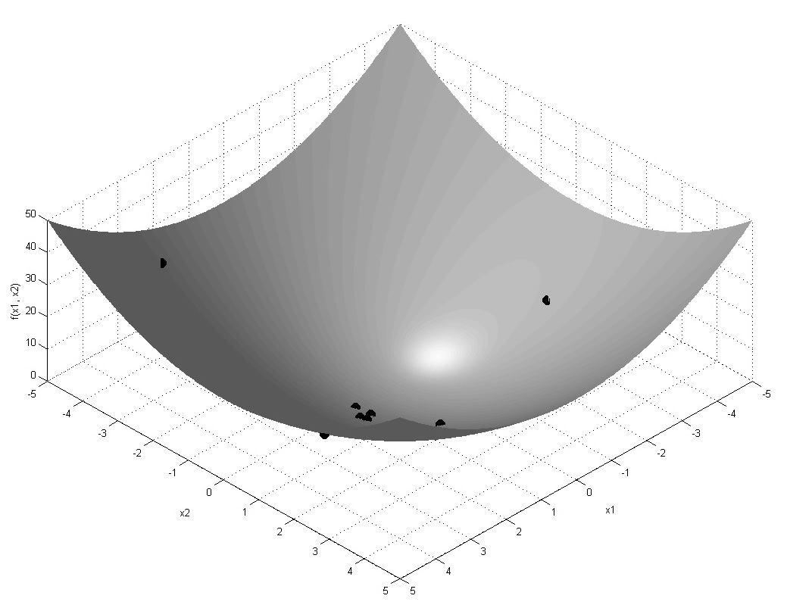

Slide 7
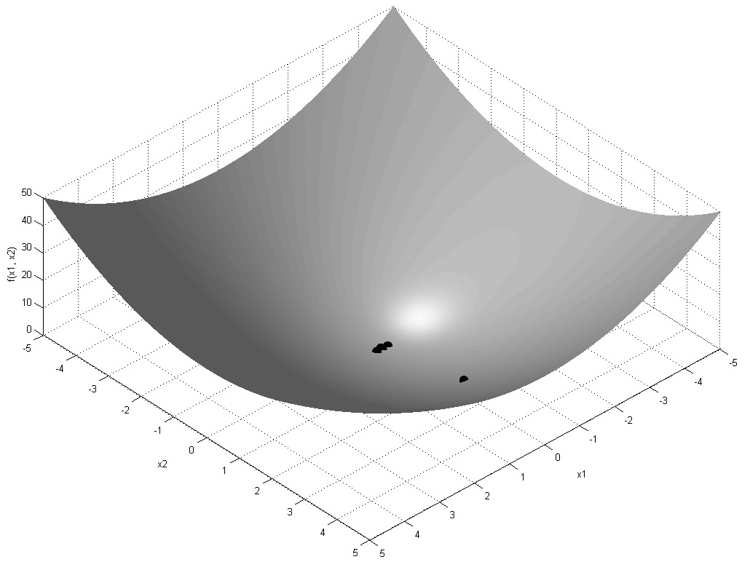

Slide 9
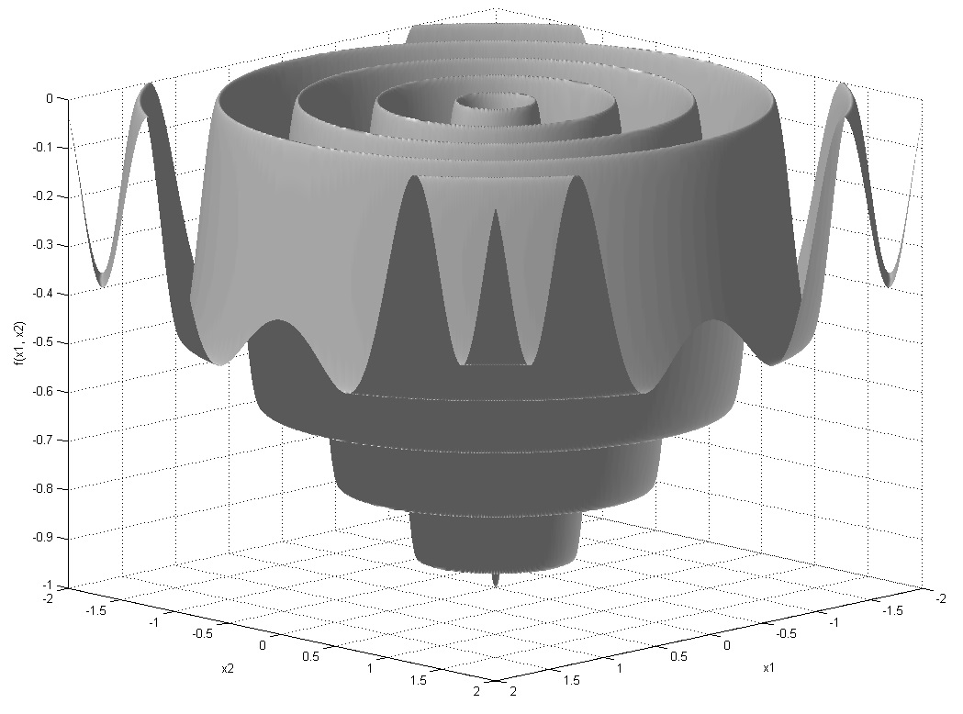

Slide 10
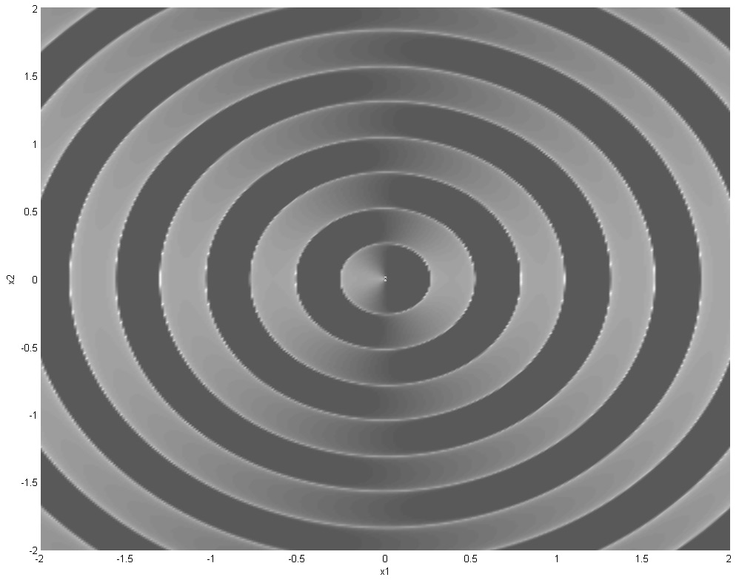

Slide 11
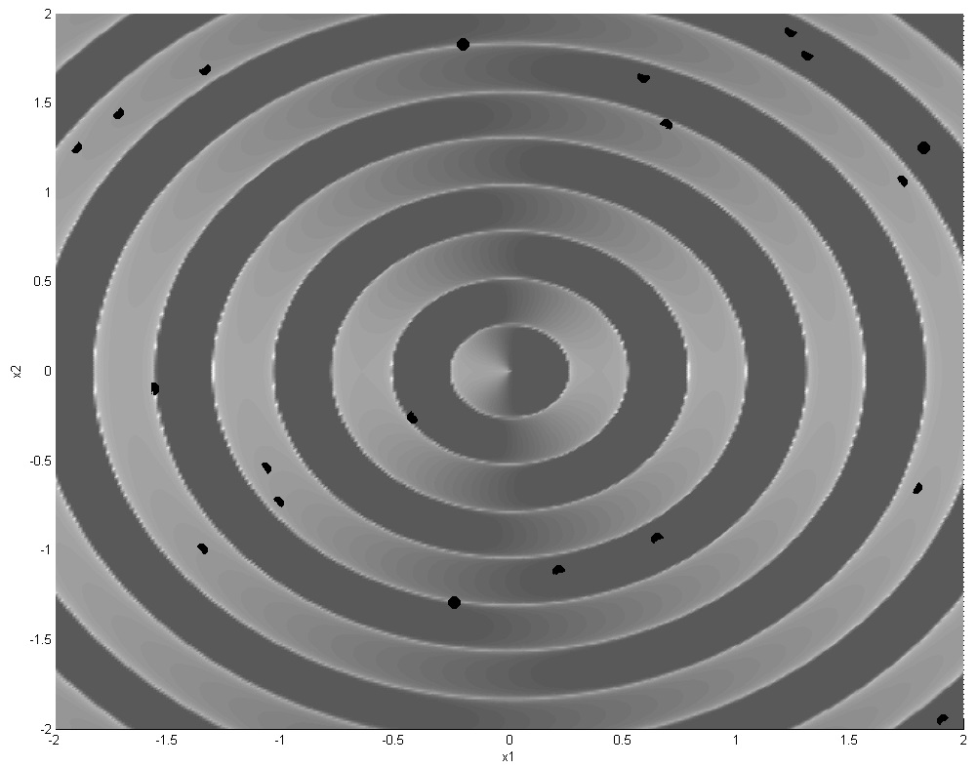

Slide 13
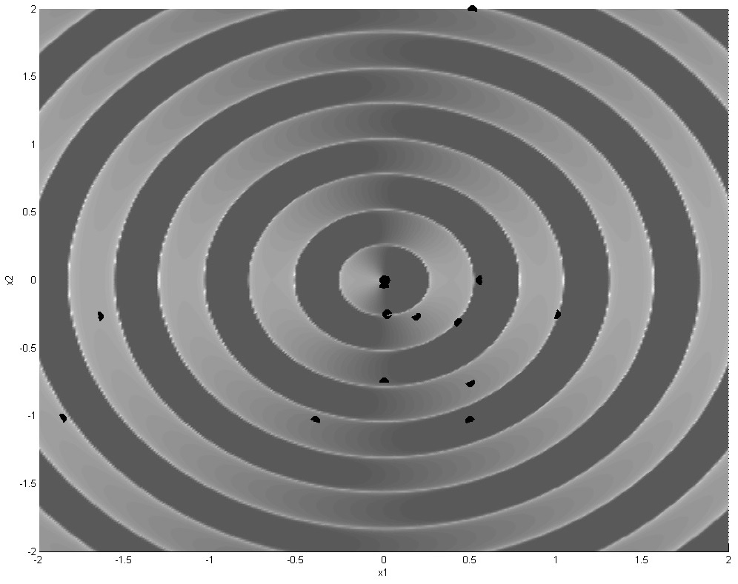

Slide 14
Optimasi Masalah Diskrit
Knapsack Problem (KP)
Sequence Alignment (SA)
Traveling Salesman Problem (TSP)
Vehicle Routing Problem (VRP)
Cutting Stock Problem (CSP)
Job Shop Scheduling (JSS)
...

Slide 15
Knapsack Problem (KP)
Pilih sejumlah barang dengan total nilai tertinggi dan berat maksimum 20 kg?
Kode | Nama objek | Jumlah | Berat (kg) | Nilai
b1 | Kamera | 1 unit | 5 | 150
b2 | Laptop | 1 unit | 7 | 220
b3 | Peralatan Mandi | 1 paket | 8 | 300
b4 | Pakaian | 1 paket | 3 | 100
b5 | Rempah-rempah | 1 paket | 9 | 100
b6 | Rice Cooker | 1 paket | 4 | 40
b7 | Buku | 1 paket | 13 | 520

Slide 16
Knapsack Problem (KP) dengan Greedy Algorithm
Kode | Nama objek | Jumlah | Berat (kg) | Nilai
b1 | Kamera | 1 unit | 5 | 150
b2 | Laptop | 1 unit | 7 | 220
b3 | Peralatan Mandi | 1 paket | 8 | 300
b4 | Pakaian | 1 paket | 3 | 100
b5 | Rempah-rempah | 1 paket | 9 | 100
b6 | Rice Cooker | 1 paket | 4 | 40
b7 | Buku | 1 paket | 13 | 520
O(n)

Slide 17
Knapsack Problem (KP) dengan Brute Force
No | Calon Solusi | Total Berat | Total Nilai
1 | {b1} | 5 | 150
2 | {b2} | 7 | 220
... | ... | ... | ...
7 | {b7} | 13 | 520
8 | {b1, b2} | 12 | 370
9 | {b1, b3} | 13 | 450
.. | ... | ... | ...
28 | {b6, b7} | 17 | 560
29 | {b1, b2, b3} | 20 | 670
30 | {b1, b2, b4} | 15 | 470
... | ... | ... | ...
 | { b2, b7} | 20 | 740
... | ... | ... | ...
127 | {b1, b2, b3, b4, b5, b6, b7} | 37 | 1430
O(2^{n})

Slide 18
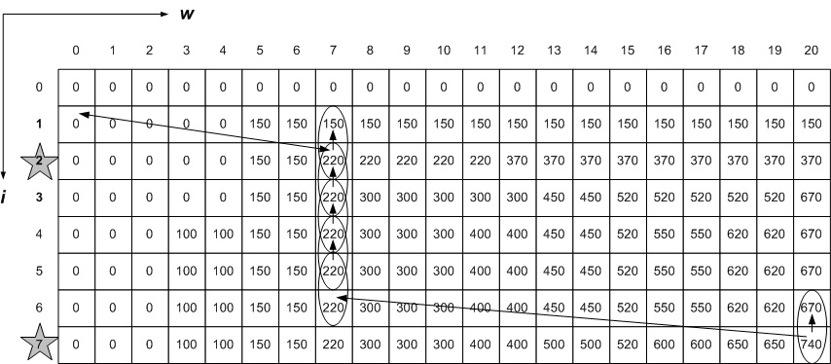
Knapsack Problem dengan Dynamic Programming
O(nW)

Slide 19
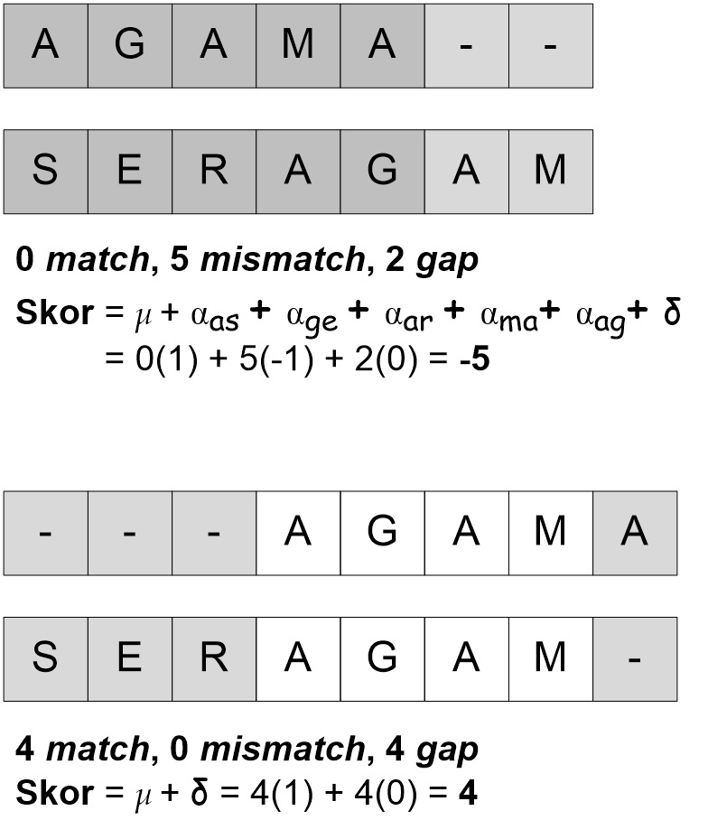
Sequence Alignment (SA)

Slide 20
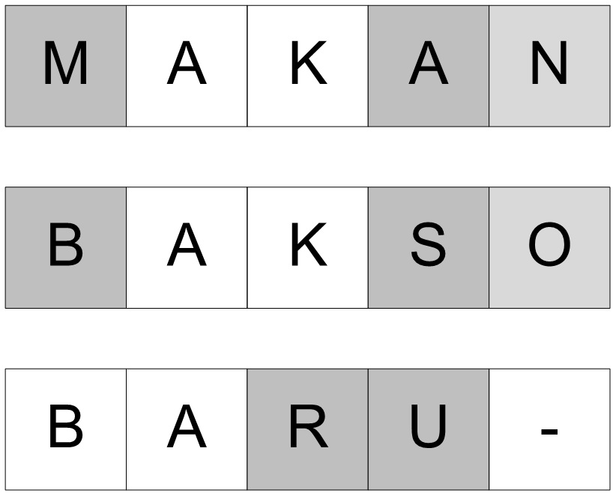
Sequence Alignment (SA)

Slide 21
Sequence Alignment (SA)

Slide 22
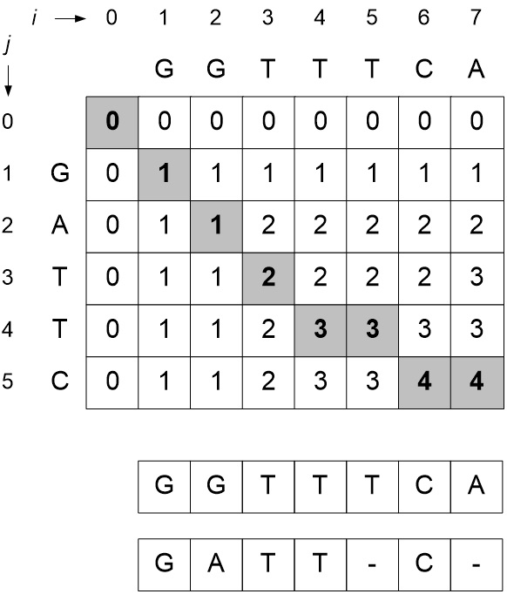
Sequence Alignment (SA)

Slide 23
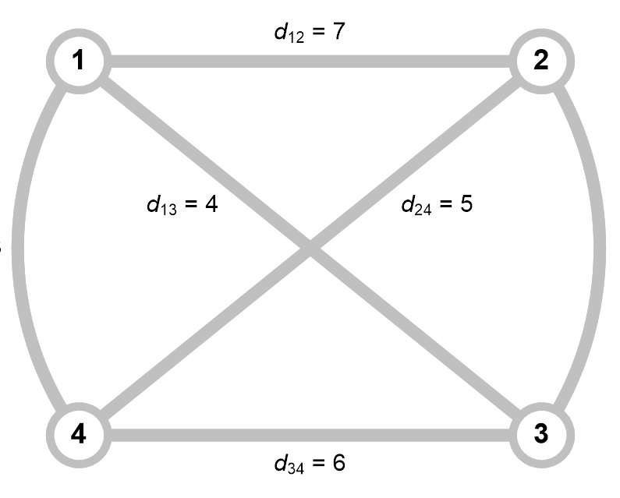
Traveling Salesman Problem (TSP)
(n - 1)!

Slide 24
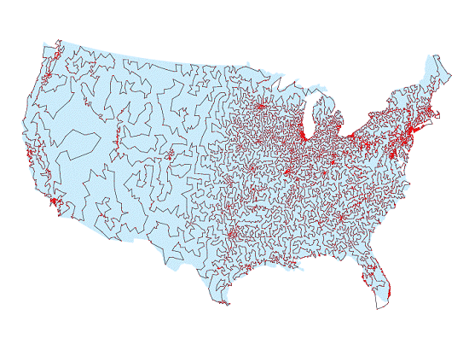
13,509 cities in the US
Traveling Salesman Problem (TSP)
http://www.nsf.gov/pubs/2002/nsf0120/nsf0120_usa.html

Slide 25
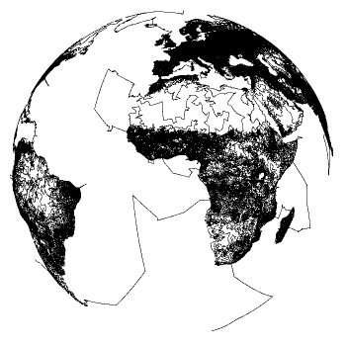
Traveling Salesman Problem (TSP)
1,904,711-city instance of locations, http://www.tsp.gatech.edu/world/images/world.anim5a.gif

Slide 26
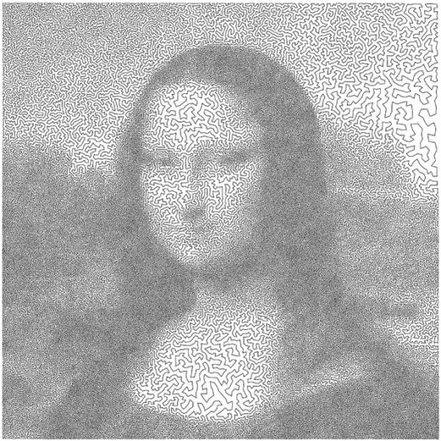
Traveling Salesman Problem (TSP)

Slide 27
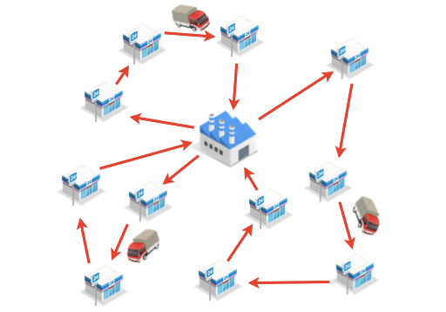
Vehicle Routing Problem (VRP)

Slide 28
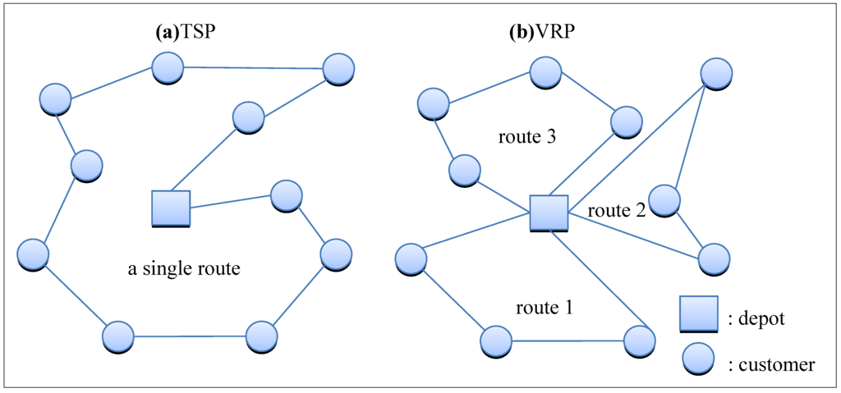

Slide 29
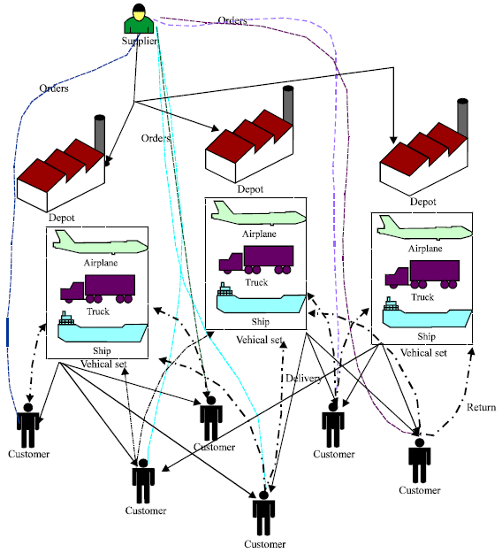
Vehicle Routing Problem (VRP)
http://scialert.net/fulltext/?doi=ajie.2012.17.29

Slide 30
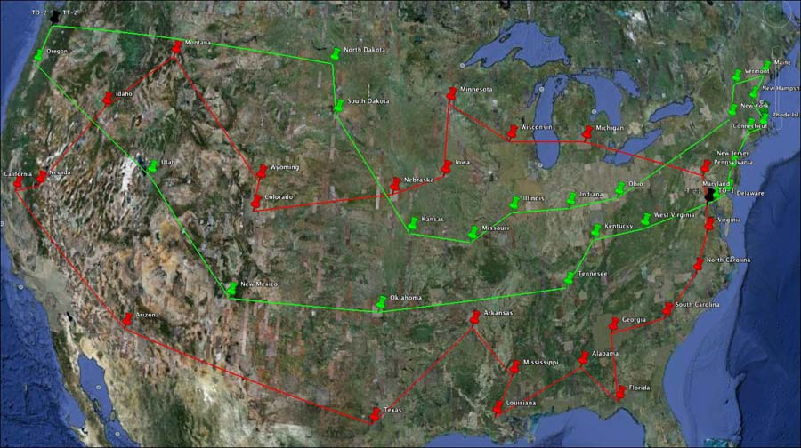
https://www.qrcodematrix.com/vehicle-routing/

Slide 31
Cutting Stock Problem (CSP)
Order potongan
11 cm
No. | Ukuran (cm²) | Jml
1 | 5 x 5 | 3
2 | 4 x 6 | 2
3 | 2 x 6 | 3
Awas !
Kertas ini mahal
Cari pola potongan yang meminimasi sisa bahan?
15 cm

Slide 32
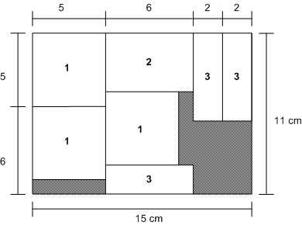

Slide 33
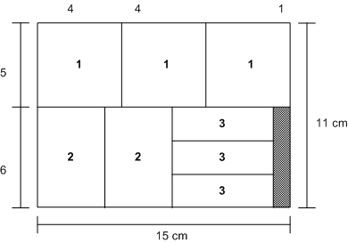

Slide 34
Job Shop Scheduling

Slide 35
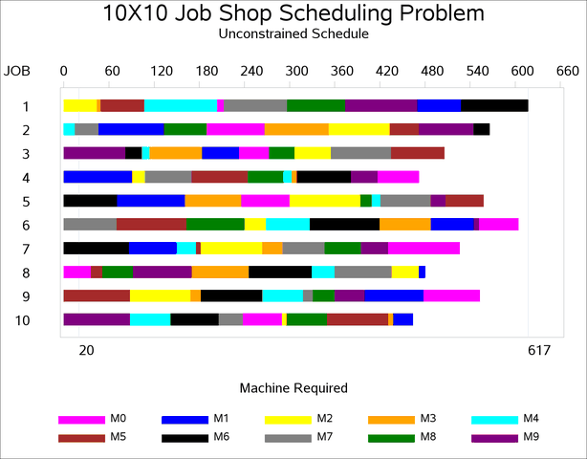
Job Shop Scheduling

